Slide 1
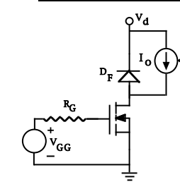
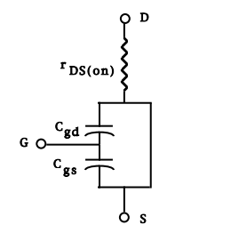
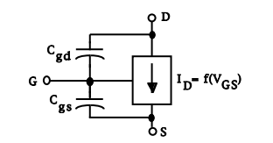
POWER MOSFET SWITCHING CHARACTERISTIC
Buck Converter as Triode Region Circuit cut-off and
Load Model Saturation Circuit Model

Slide 2
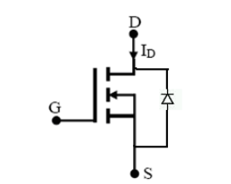
Switching Devices Categories:
Uncontrolled: Diodes
Semi controlled: Thyristors
Fully controlled/Controlled: Transistors

Slide 3
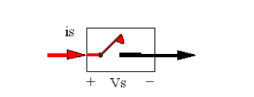
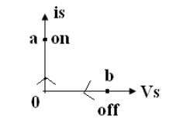
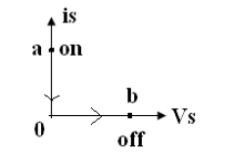
İdeal Switch
On-state : Vs=0
Off-state: is=0;
Thus, Power dissipation is zero.

Slide 4
Practical Switch
Conduction Loss
Blocking Loss
Turn on Loss
Turn of Loss
Driver Circuit Loss

Slide 5
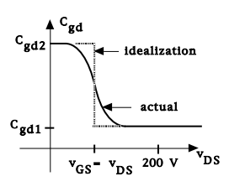
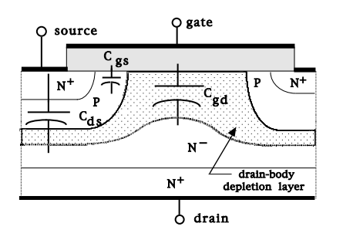
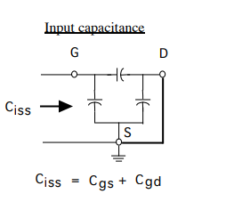
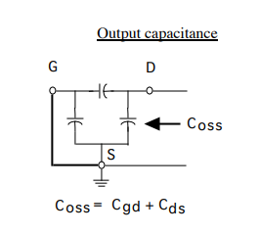
Mosfet Capacitance
Cgs is almost constant
Cgd vaties with Vds

Slide 6
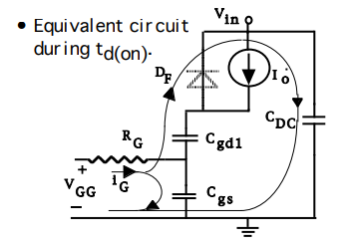
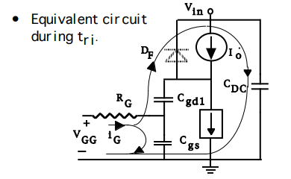
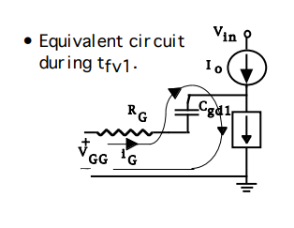
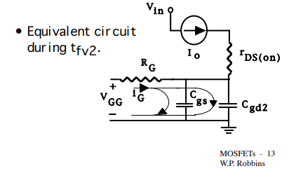
Turn-on and Turn-of Equaivalent Circuits

Slide 7
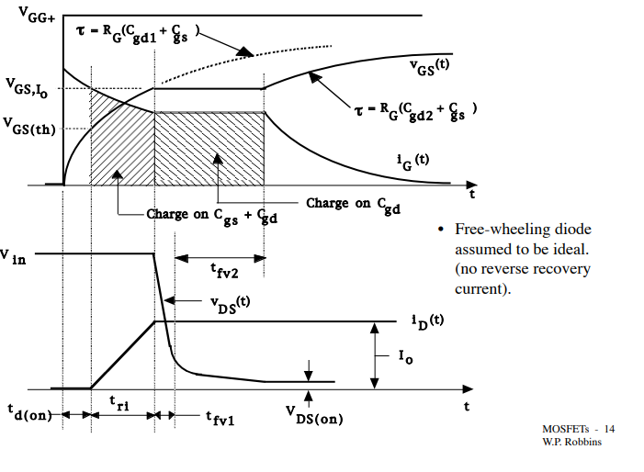
Turn-on Wavefroms

Slide 8
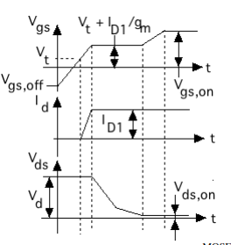

Slide 9
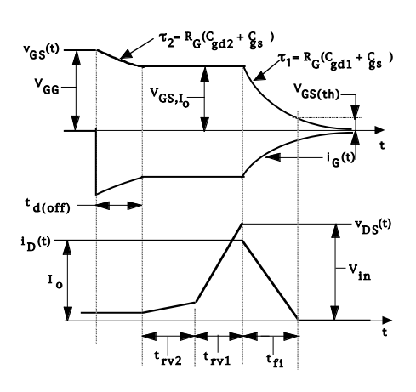
Turn-off Waveforms

Slide 10
On-state Losses
Pon= Io^2*Rds(on)
Rds(on) changes with Vgs and temperature
.
Large Vgs make layer and channel resistances smaller.
If temperature increases, Rds(on) increase.(Decreasing carrier mobility)

